Slide 1

G H PATEL COLLEGE OF ENGINEERING AND TECHNOLOGY BAKROL GATE, VALLABH VIDHYANAGAR, ANAND
Gajera jagdishkumar
190110116019
Branch: Information Technology
Subject: Summer Internship/Project- 3170001
Academic Year: 2022-23

Slide 2
Placement Prediction using Data Science

Slide 3
Introduction
Placements are considered to be very important for each and every college. The basic success of the college is measured by the campus placement of the students. Every student takes admission to the colleges by seeing the percentage of placements in the college. Hence, in this regard the approach is about the prediction and analyses for the placement necessity in the colleges that helps to build the colleges as well as students to improve their placements.

Slide 4
Objective
The objective of the Placement Prediction system is that it will be predicting the probability of an under graduate students getting placed in company by applying classification algorithms such as random forest and Decision Tree. The main objective of this model is to predict whether the student he/she gets placed or not in campus recruitment. For this the data consider is academic history of students like overall percentage, backlogs, and credits.

Slide 5
Scope
Students will get complete knowledge of the placement process.
Students will get enough time for preparation.
Everyone will able to know their strength and weakness in which area they need to work.
Their route to reach their goals will be much easier as well will be helping them at every step.

Slide 6
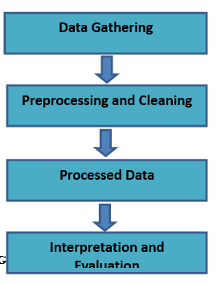
Design Methodology

Slide 7
Data Gathering
In this phase gather the data from colleges. The combination of various attributes determines whether the student is placed or not. There are many places to find your free datasets for your projects. Like Kaggle, Earth Data, Data.Gov, etc. For my project I took dataset from Kaggle.
The dataset contains various information about the students.
Age
Gender
Stream
History of backlogs
Hostel
Internships
CGPA
Placed or not

Slide 8
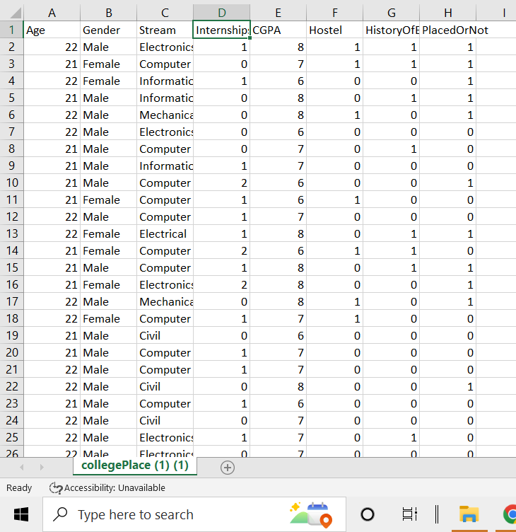

Slide 9
Pre-Processing and Cleaning
When it comes to creating a Machine Learning model, data preprocessing is the first step marking the initiation of the process. Data preprocessing in Machine Learning refers to the technique of preparing (cleaning and organizing) the raw data to make it suitable for a building and training Machine Learning models. In simple words, data preprocessing in Machine Learning is a data mining techniques that transforms raw data into an understandable and readable format.

Slide 10
Steps in Data Preprocessing
Import all the crucial libraries
Python is a very powerful and flexible programming language. This is an open-source language has created quite a few tools to efficiently work with a python. There are some basic libraries which are essential for building a project:
Pandas: Pandas is used for data manipulation and analysis.
Seaborn: It is a Python data visualization library based on matplotlib. It provides a high-level interface for drawing attractive and informative statistical graphics.
Scikit-learn: It is used to build a machine learning model. It is built on NumPy, SciPy, and matplotlib.
NumPy: NumPy is a python library also called as Numeric python which can execute scientific computing. with the help of a NumPy library you can create and perform manipulations on an array.

Slide 11
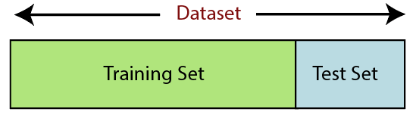
2. Import the dataset:
In this step, you need to import the dataset/s that you have gathered for the ML project at hand. Importing the dataset is one of the important steps in data preprocessing in machine learning.
3. Encoding the categorical data
In this step, Machine Learning techniques transforms raw data into an understandable and readable format. Like example in our project Gender and Stream causes problem ; So we must convert in numerical values.
4. Splitting the dataset
It is the next step in data preprocessing in machine learning. Every dataset for Machine Learning model must be split into two separate sets – training set and test set.

Slide 12
Processed Data
Processing is a method in which different algorithms applied on data to find the best results:
Decision Tree algorithm
Random Forest algorithm
Logistic Regression algorithm
K-neighbors algorithm
Support Vector Machine(SVM) algorithm

Slide 13
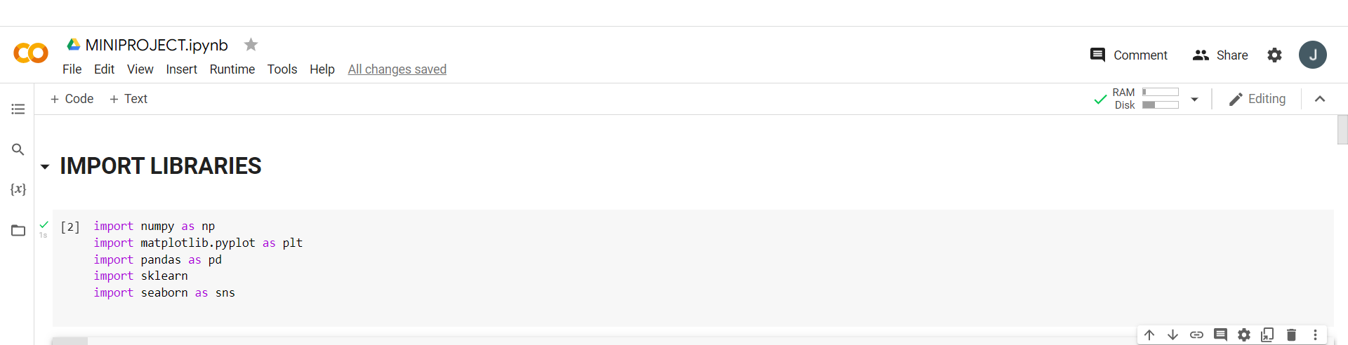
Implementation

Slide 14
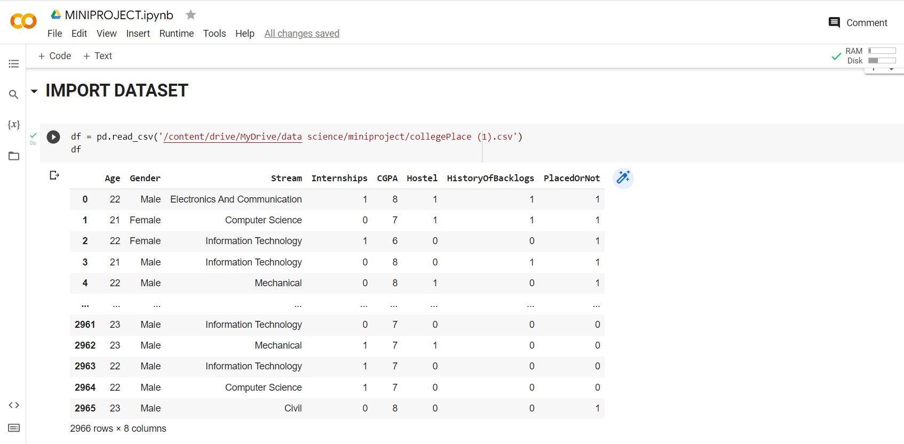

Slide 15
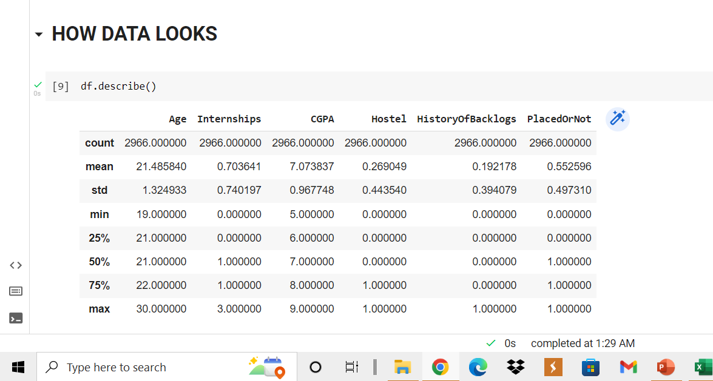
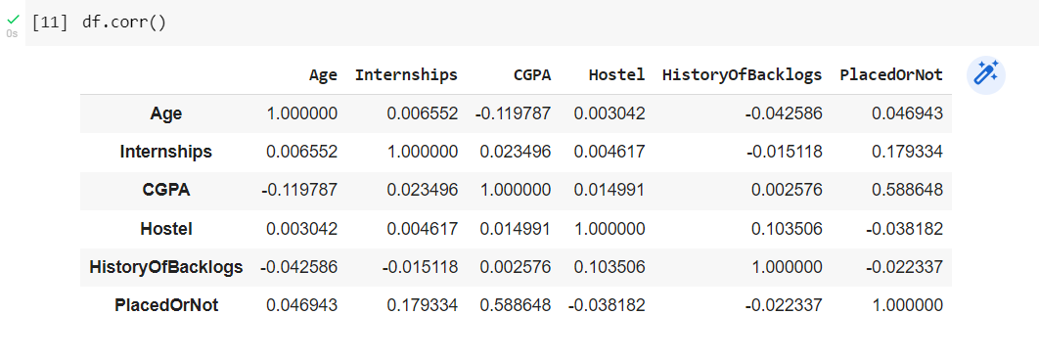

Slide 16
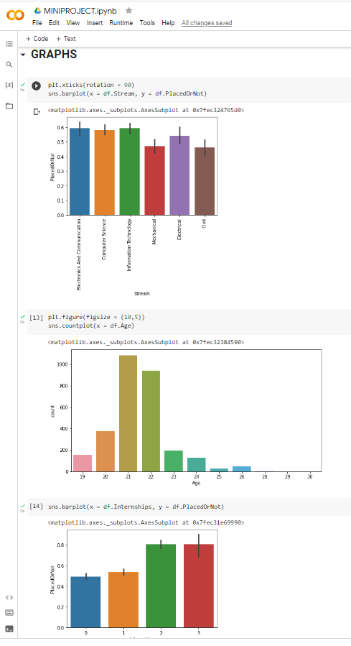

Slide 17
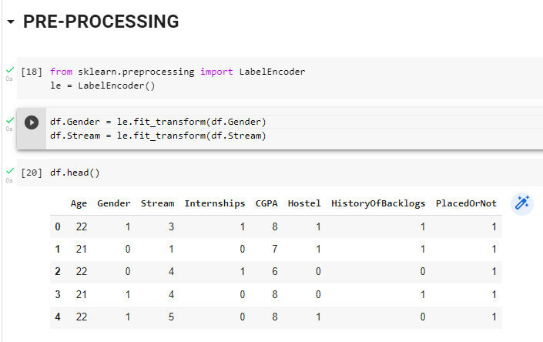

Slide 18
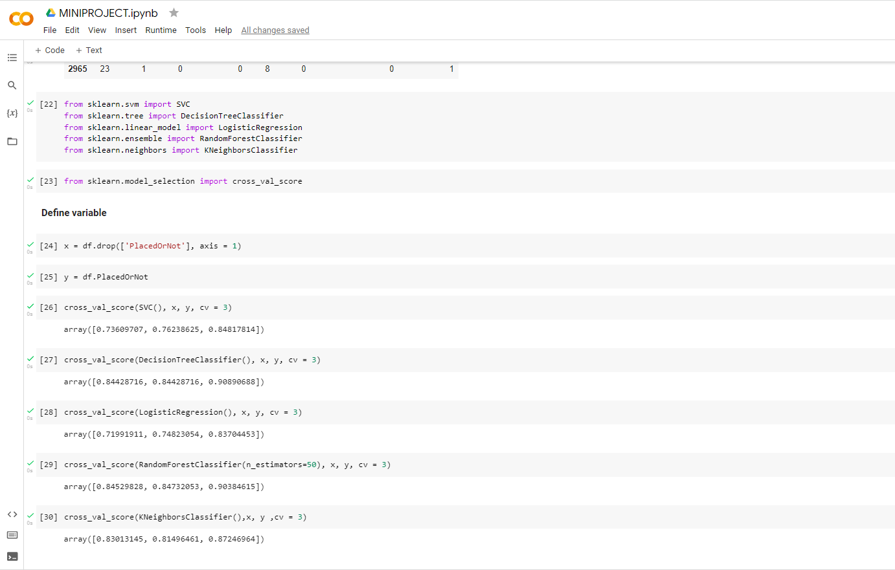

Slide 19
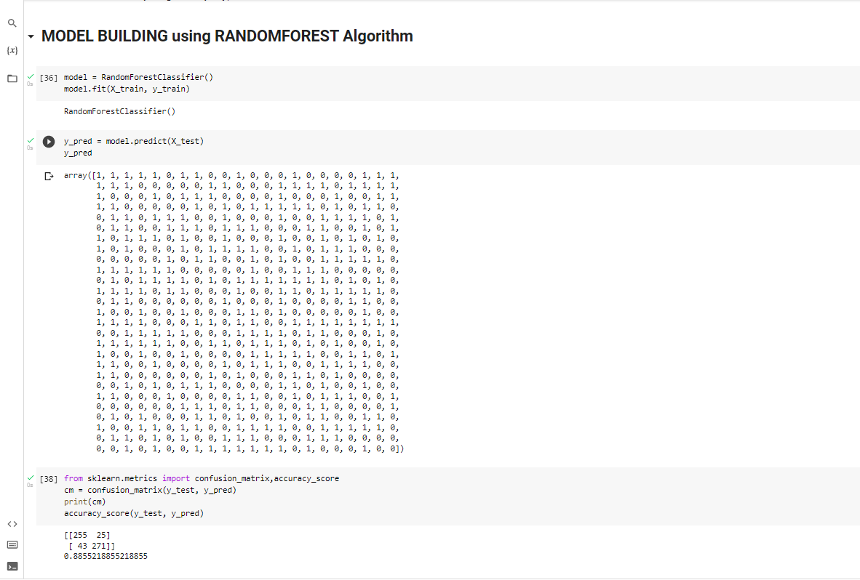

Slide 20
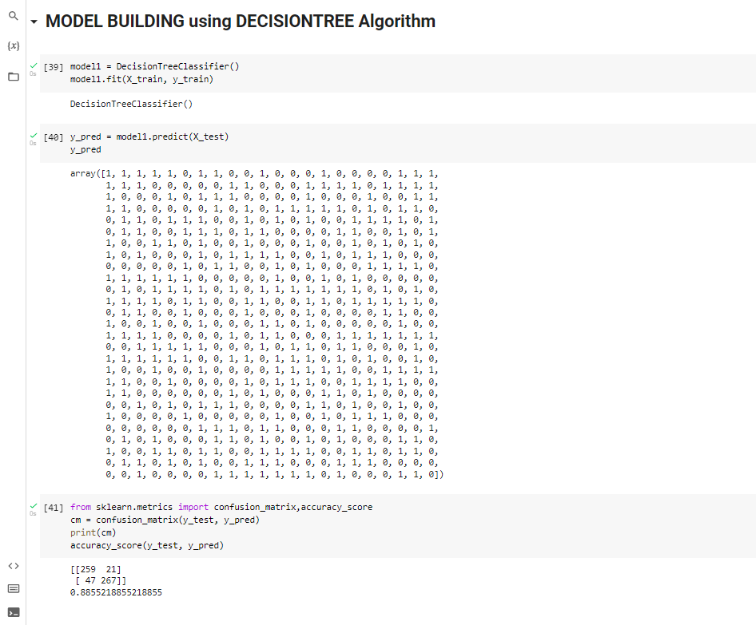

Slide 21
Conclusion
This system is beneficial for institutions to predict student’s campus placement and placement officers can work on identifying the weakness of each student.
They can also suggest improvements so that the student can overcome the weakness and supply to the best of their abilities.
Algorithms like random forest and decision tree will give maximum accuracy to the prediction.

Slide 22
Future Work
The future enhancements of the project are to focus on adding some more parameters to predict more well organized placement status.
We can also enhance the project by predicting some solutions or suggestions for the output generated by the system.

Slide 23
REFERENCES
https://www.kaggle.com/

Slide 24
THANK YOU!

